Slide 1


© 2014 Microsoft Corporation. All rights reserved. Microsoft, Windows, and other product names are or may be registered trademarks and/or trademarks in the U.S. and/or other countries.
The information herein is for informational purposes only and represents the current view of Microsoft Corporation as of the date of this presentation. Because Microsoft must respond to changing market conditions, it should not be interpreted to be a commitment on the part of Microsoft, and Microsoft cannot guarantee the accuracy of any information provided after the date of this presentation. MICROSOFT MAKES NO WARRANTIES, EXPRESS, IMPLIED OR STATUTORY, AS TO THE INFORMATION IN THIS PRESENTATION.

Slide 2

Microsoft
DevCamp
Windows 10
Clemens Schotte
Technical Evangelist
@cschotte
cschotte@microsoft.com

Slide 3
Before Windows 10…

Slide 4
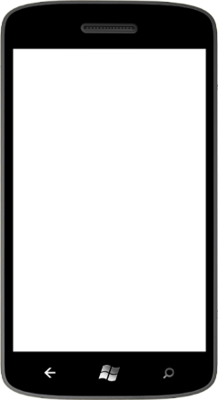

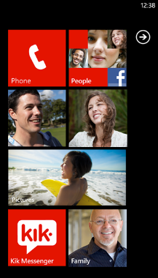
Windows Phone 7
2010
CE
Silverlight
7.5: Internet Explorer 9

Slide 5
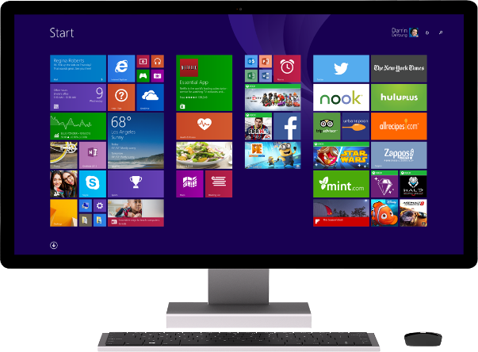
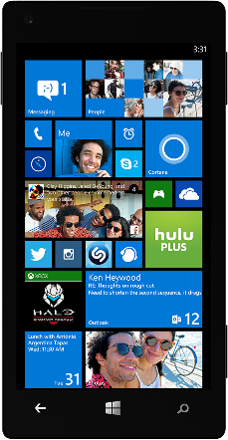
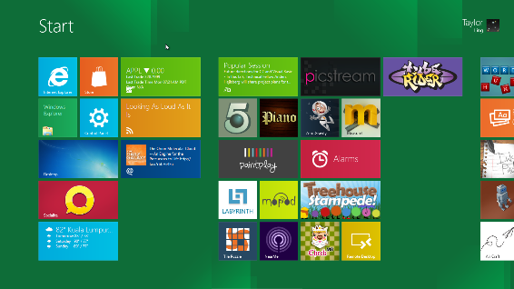
Windows Phone 7
Windows Phone 8
Windows 8
2010
2012
CE
NT
NT
Silverlight
Silverlight
WinRT
Kernel, IE10, C++/DX,
developer platform (partially)
7.5: Internet Explorer 9

Slide 6
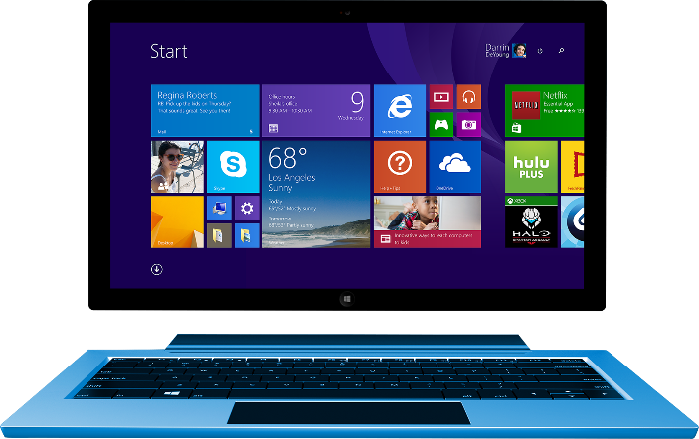
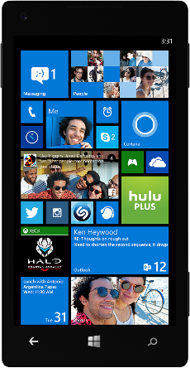
Windows Phone 7
Windows Phone 8
Windows 8
Windows 8.1
Windows Phone 8.1
2010
2012
2013
2014
CE
NT
NT
NT
Silverlight
Silverlight
WinRT
WinRT
Kernel, IE10, C++/DX,
developer platform (partially)
Developer platform, Stores,
Core platform
7.5: Internet Explorer 9

Slide 7

Our Windows convergence is almost complete
Xbox 360
Xbox One
Unified core and app platform
Converged
OS kernel
Windows 8
Windows 8.1
Converged
app model
Windows 10
Windows Phone 8.1
Windows Phone 8
Easy for users to get & stay current
Windows Phone 7.5
Windows on Devices

Slide 8
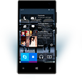

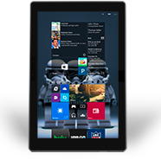
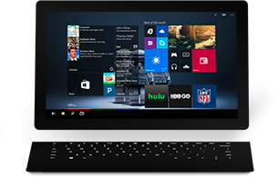

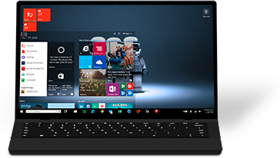

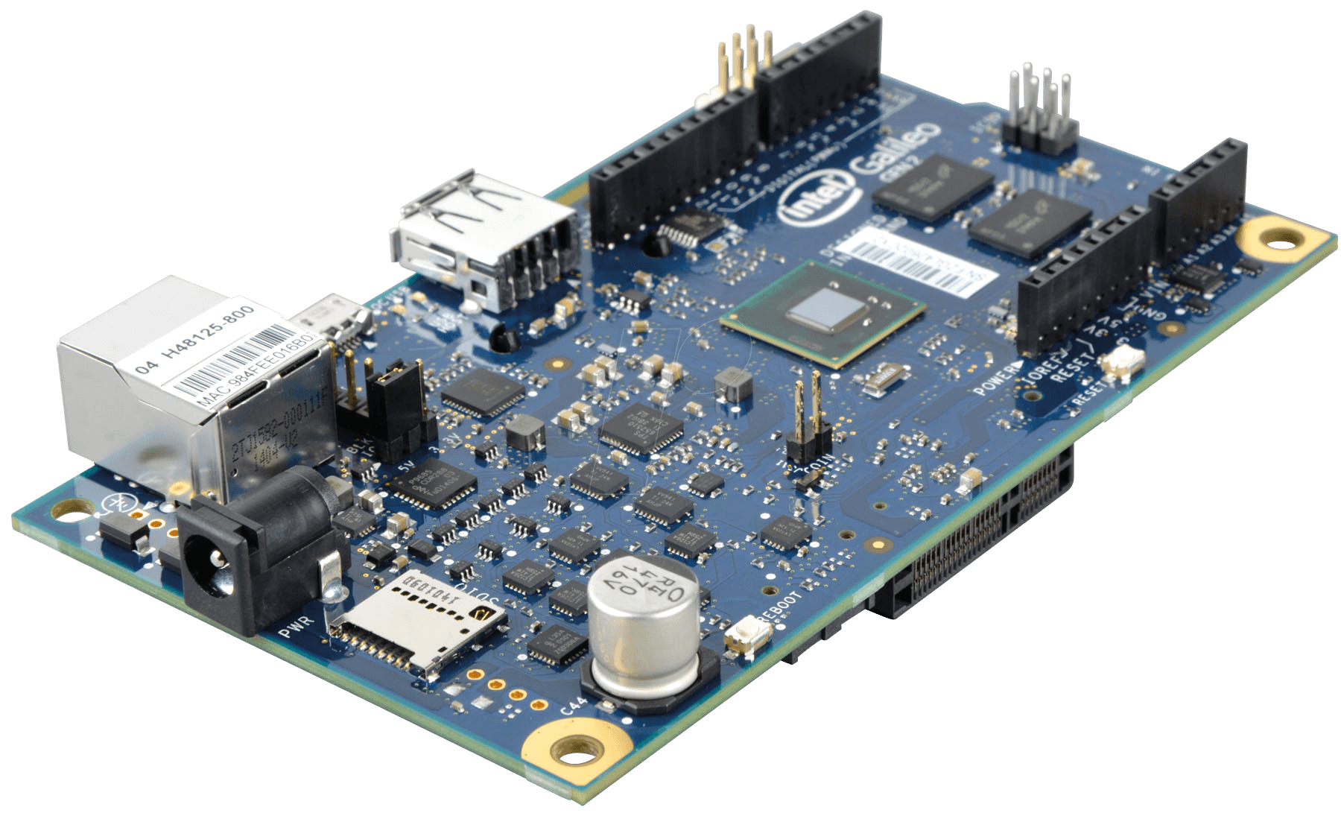
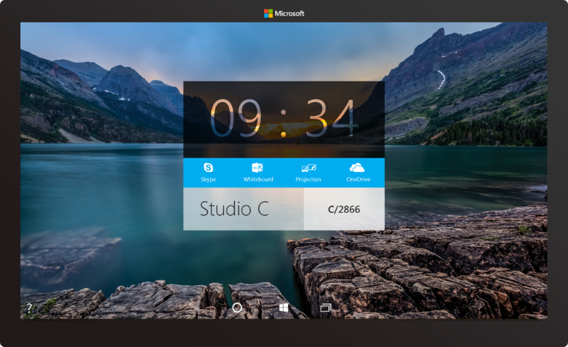


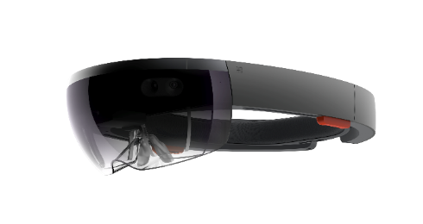
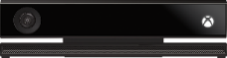
Windows 10 powers a huge range of hardware…
Devices
Platform
Phone
Phablet
Small Tablet
Large Tablet
2-in-1s (Tablet or Laptop)
Classic Laptop
Desktops & All-in-Ones
Fix IoT image,
Replace PPI with hub
IoT
HoloLens
Surface Hub
Xbox

Slide 9


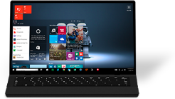

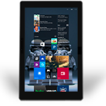



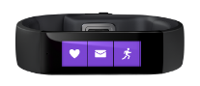






…with one dev platform reaching every device
Devices
Platform
Desktop
Surface Hub
Windows Universal Platform
Phone + Tablet
IoT + Wearables
Xbox
Adaptive UI + Controls
Full Support for Existing Code
Natural User Inputs
Monetization + Distribution
Live Tiles + Notifications
Notes:
To bring the family together, Windows 10 is built upon a unified core (Windows core) and a unified app platform (Windows universal platform), meaning that all of our device families run Windows at their core. This provides the consistency that users need and the tailored experiences desire.
Gone are the days of Microsoft maintaining a number of code-bases that works to build bridges across silos; Windows has evolved to do that itself. And gone are the days of ISVs doing this as well – targeting Windows provides a single roadmap to the billion+ Windows screens.
Enabling this consistent, yet tailored, Windows experience are a number of services:
Adaptive UX: User interface design that adapts and reacts to the device family it’s running on
Natural user inputs: Speech, natural ink, gesture and facial recognition
Cloud-based intelligent services: Cortana AI, personal hubs, OneDrive, Office 365, Windows notification services, credential locker
Windows Store: Universally available apps and games, digital media
For the app builder, this also means that you can build one Windows solution that runs across all of the Windows device families, and use these Windows services to tailor your experience at runtime.

Slide 10
Demo

Slide 11
Universal Windows Platform (UWP)

Slide 12
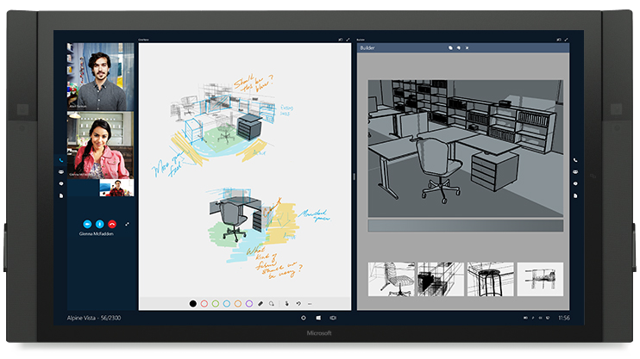
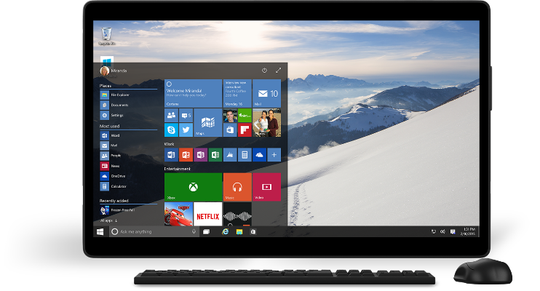
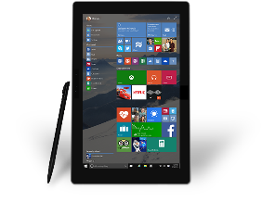
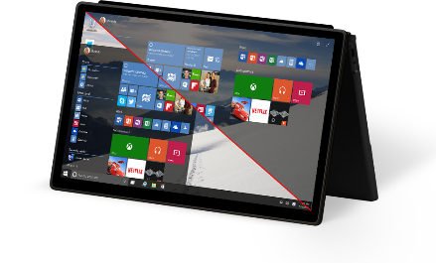
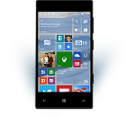

The Windows 10 opportunity
Windows Developer Platform
Growing Reach with Universal Windows Apps
Improving User Engagement

Slide 13

Universal Windows Platform
Wherever your code was born, you can bring it to Windows
Windows Platform
Web Platform
Universal Windows 8 Apps (C++/C#/JS)
Microsoft Edge HTML Engine
Universal Windows 10 Apps (C++/C#/JS)
Surface Hub
Desktop
Cordova Tooling (HTML/JS)
“Project Centennial” (Classic Apps)
“Project Westminster” (HTML/JS)
Universal Windows Platform
IoT
Xbox
Middleware Platforms
Other Mobile Platforms
Middleware Partners (e.g., Xamarin)
Holographic
Mobile
“Project Astoria” (Java/C++)
Game Engine Partners (e.g., Unity)
“Project Islandwood” (Objective C/C++)

Slide 14
Why do we need an app model?
Windows has never had a definition of an app
You know it when you see it but it’s never written down
Started with .exe but…
How do you install it?
How do you store state?
How long does the app run for?
What’s the versioning story?
How do you integrate with the OS?
How do you integrate with other apps?
What can your app do?
The UWP App Model provides answers to these questions

Slide 15
What is the UWP App Model
Defines the app lifecyle
Unified across all Windows devices
Scales from IoT → Mobile → PC → Xbox → HoloLens
Cradle to Grave
Install
Runtime environment
Resource Management
Update
Data Model
Uninstall

Slide 16
UWP App Model
Inclusive of all apps that run on Windows
Universal Windows Apps
Existing apps
Phone Apps
Windows 8.1 Apps
Classic Windows Apps

Slide 17
Visual Studio 2015

Slide 18
Universal Windows App Development Tools
Visual Studio 2015 RC with
Install latest Windows 10 OS (10.0.10074.0)
insider.windows.com
Install VS 2015 RC w/ Universal Windows SDK & Tools
www.visualstudio.com
Build your first Universal Windows App

Slide 19
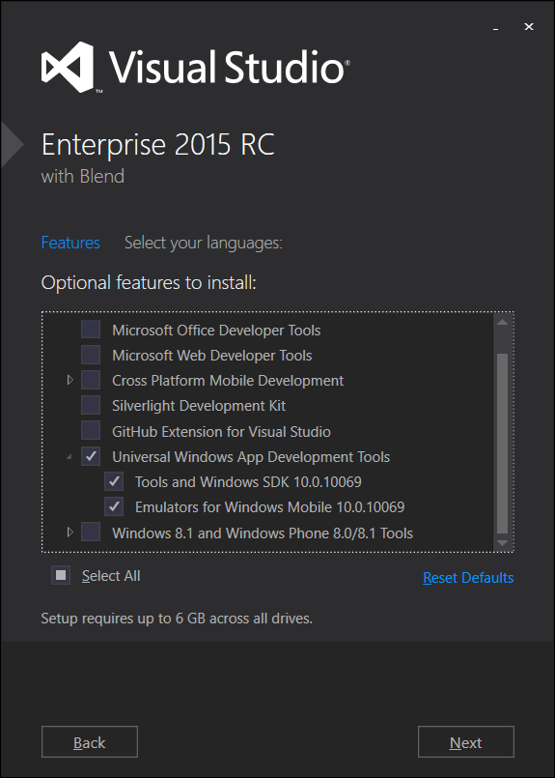
Acquiring Windows 10 Tools/SDKs/Emulators
Select “Universal Windows App Development Tools” using Custom setup option

Slide 20
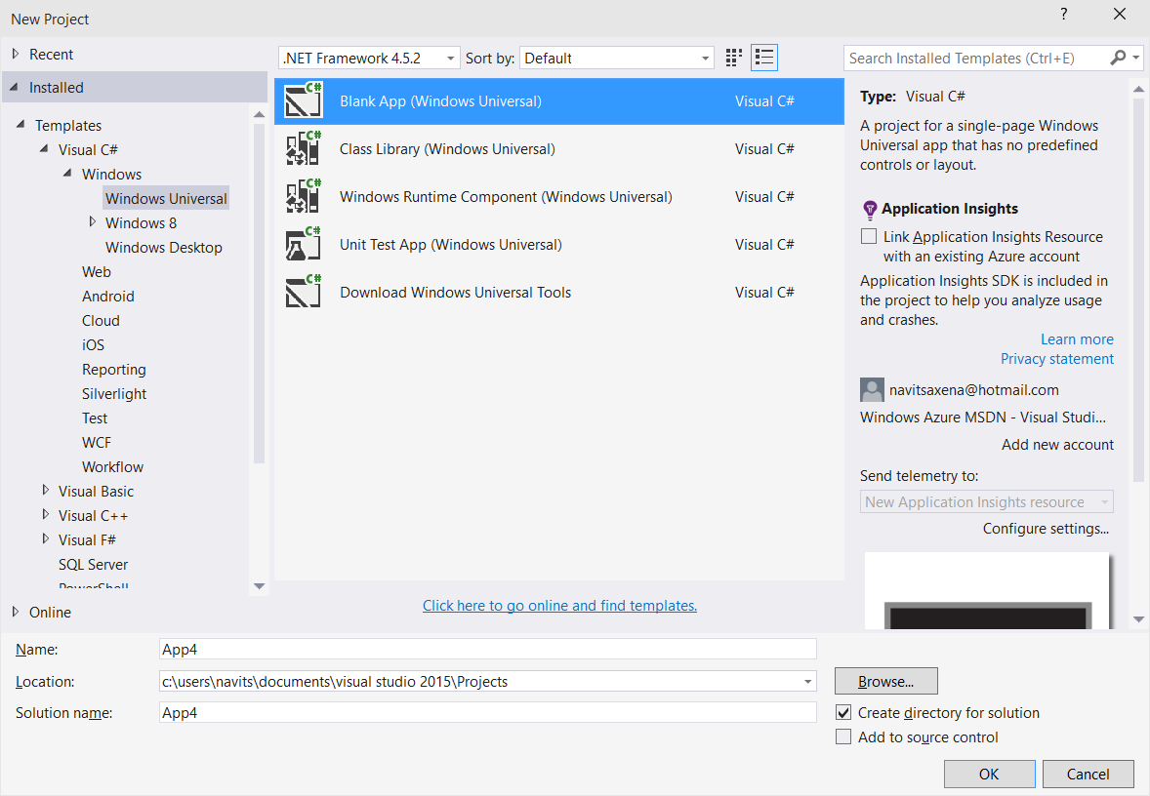
Project Templates

Slide 21
Demo

Slide 22
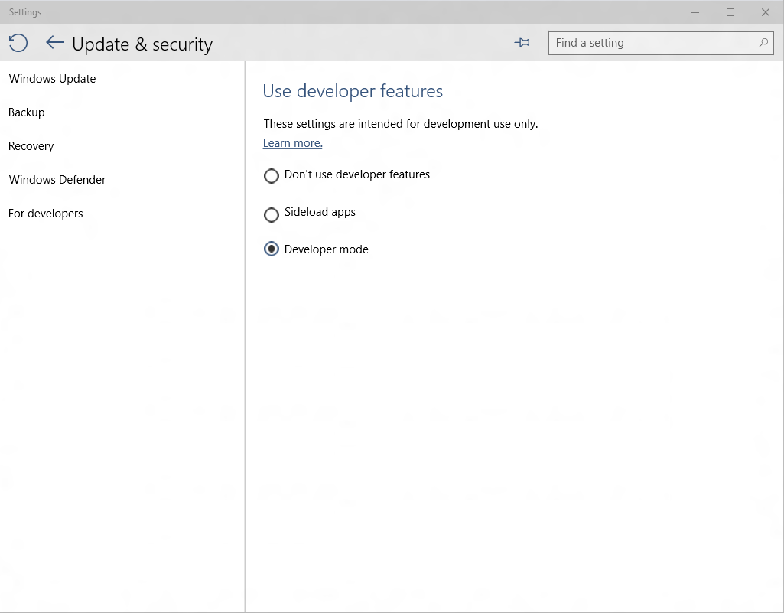
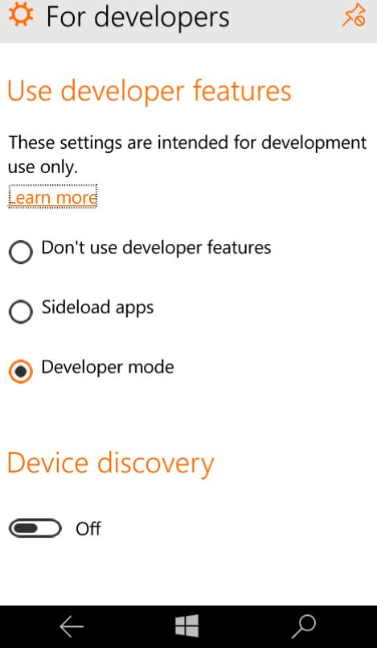
How easy is it to unlock?
No muss, no fuss..

Slide 23
Universal Windows Samples
https://github.com/Microsoft/Windows-universal-samples

Slide 24
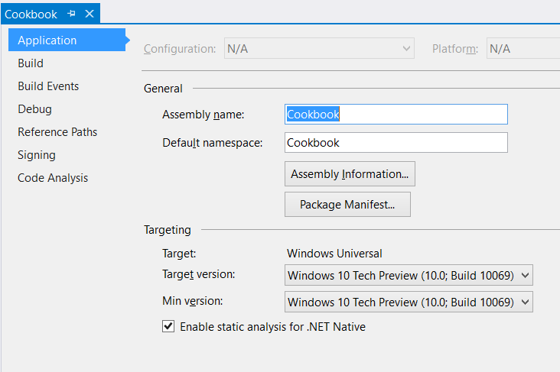
Project Properties
Target version (TargetPlatformVersion)
Defines the version of Universal Windows SDK being targeted by project
Defines the available API surface for the application
Is stamped as TargetDeviceFamily.MaxVersionTested property in the AppX manifest file as part of the build process
<Dependencies>
<TargetDeviceFamily
Name="Windows.Universal" MinVersion="10.0.10069.0" MaxVersionTested="10.0.10069.0" />
</Dependencies>

Slide 25
Project Properties
Min version (TargetPlatformMinVersion)
Defines the minimum version of Universal Windows platform being supported by the project (adaptive application package)
Is stamped as TargetDeviceFamily.MinVersion property in the AppX manifest as part of the build process
<Dependencies>
<TargetDeviceFamily
Name="Windows.Universal" MinVersion="10.0.10069.0" MaxVersionTested="10.0.10069.0" />
</Dependencies>

Slide 26
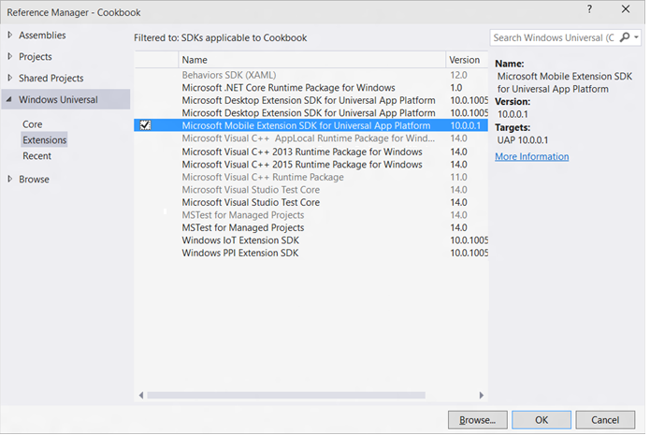
Windows Device Family Extension SDKs
Use device family specific APIs by adding references to Windows Device Family Extension SDKs

Slide 27
Adaptive Code
Use Windows.Foundation.Metadata.ApiInformation APIs to write adaptive code across different Universal Windows versions or different target device families
if (Windows.Foundation.Metadata.ApiInformation.IsTypePresent
("Windows.Phone.UI.HardwareButtons"))
{
Windows.Phone.UI.Input.HardwareButtons.BackPressed += HardwareButtons_BackPressed;
}

Slide 28
3rd Party Extension SDKs
Developers can reference Windows 8.1 Extension SDKs in a Universal Windows app
Referencing a native Windows 8.1 Extension SDK requires referencing “Microsoft Visual C++ 2013 Runtime Package for Windows Universal” SDK
Developers can build Extension SDKs for Universal Windows platform and write adaptive code against platform APIs
Universal Windows Extension SDKs are installed under:
\Program Files\Microsoft SDKs\Windows Kits\10\ExtensionSDKs

Slide 29
3rd Party Extension SDKManifest.xml
<FileList
TargetPlatform="UAP"
MinVSVersion="14.0"
SDKType="External"
TargetPlatformMinVersion="10.0.10069.0"
TargetPlatformVersion="10.0.10069.0"
DisplayName = "Sample Extension SDK"
AppliesTo = "WindowsAppContainer + (Managed | Javascript)"
SupportsMultipleVersions="Error">
<File Reference = "Sample.winmd">
<ToolboxItems VSCategory = "Toolbox.Default"/>
</File>
</FileList>

Slide 30
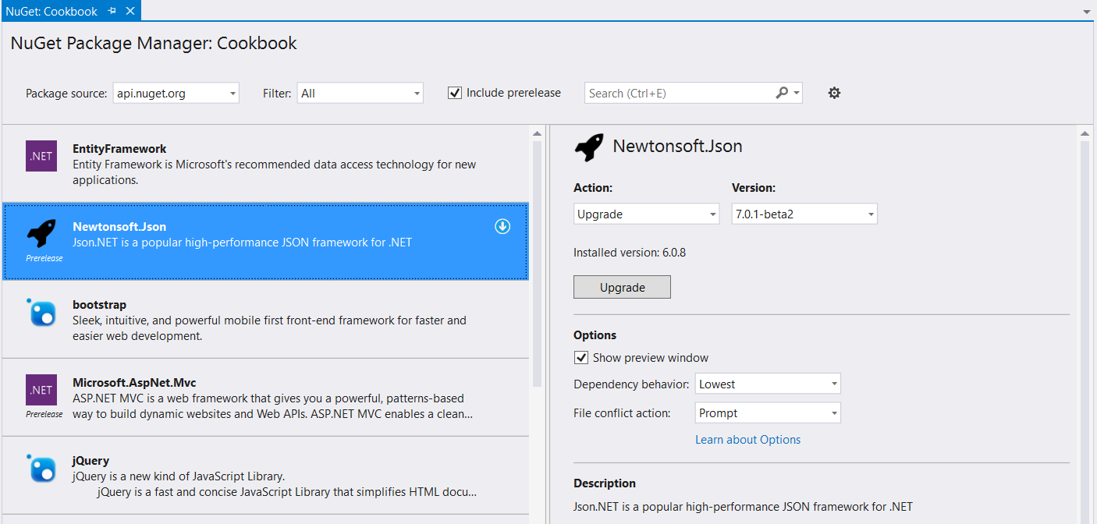
NuGet
Universal Windows apps support referencing Windows 8.1 NuGet packages
Developers will be able to author NuGet packages specific to Universal Windows platform

Slide 31
Application Insights
App Insights enable developers to monitor app’s performance and usage statistics
Universal Windows project templates are enabled for App Insights and monitors app users, sessions, page view, crashes and real time usage without writing any additional code
Developers can easily add custom events to collect additional telemetry data for the app

Slide 32
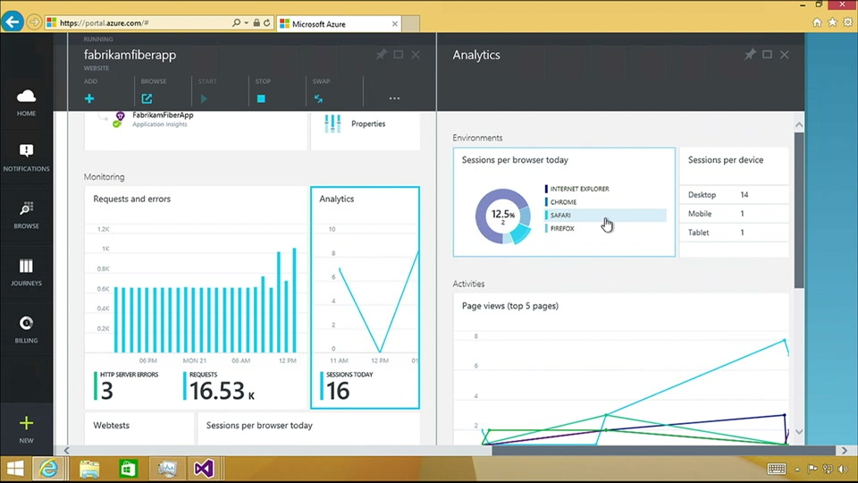
Application Insights

Slide 33
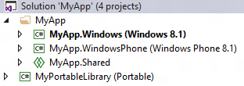
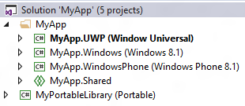
Universal 8.1 App
Upgrade Windows/Windows Phone 8.1 projects
Add single Universal Windows project to target different Windows 10 devices
Use Adaptive code for device family specific APIs
Use Adaptive UI to support different form factors
Use Shared projects, WinRT components, PCLs to share code between Universal Windows, Windows 8.1 and WP 8.1 projects
1: Single Universal Windows Project

Slide 34
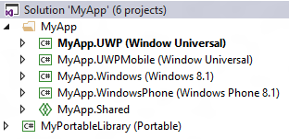
Universal 8.1 App
Add a new Universal Windows project to target a specific Windows 10 device (ex: Mobile)
Update Package.appxmanifest to include “Windows.Mobile” device family with matching MinVersion/MaxVersionTested
<Dependencies>
<TargetDeviceFamily
Name="Windows.Mobile"
MinVersion=“<Windows.Mobile MinVersion>“
MaxVersionTested=“<Windows.Mobile MaxVersionTested>"/>
</Dependencies>
Add a new Universal Windows project to target other Windows 10 devices
Use Shared projects, WinRT components, PCLs to share code between Universal Windows, Windows 8.1 and WP 8.1 projects
2: Different project/package for a device family

Slide 35
Internet of Things

Slide 36
Windows on the Internet of Things

Slide 37
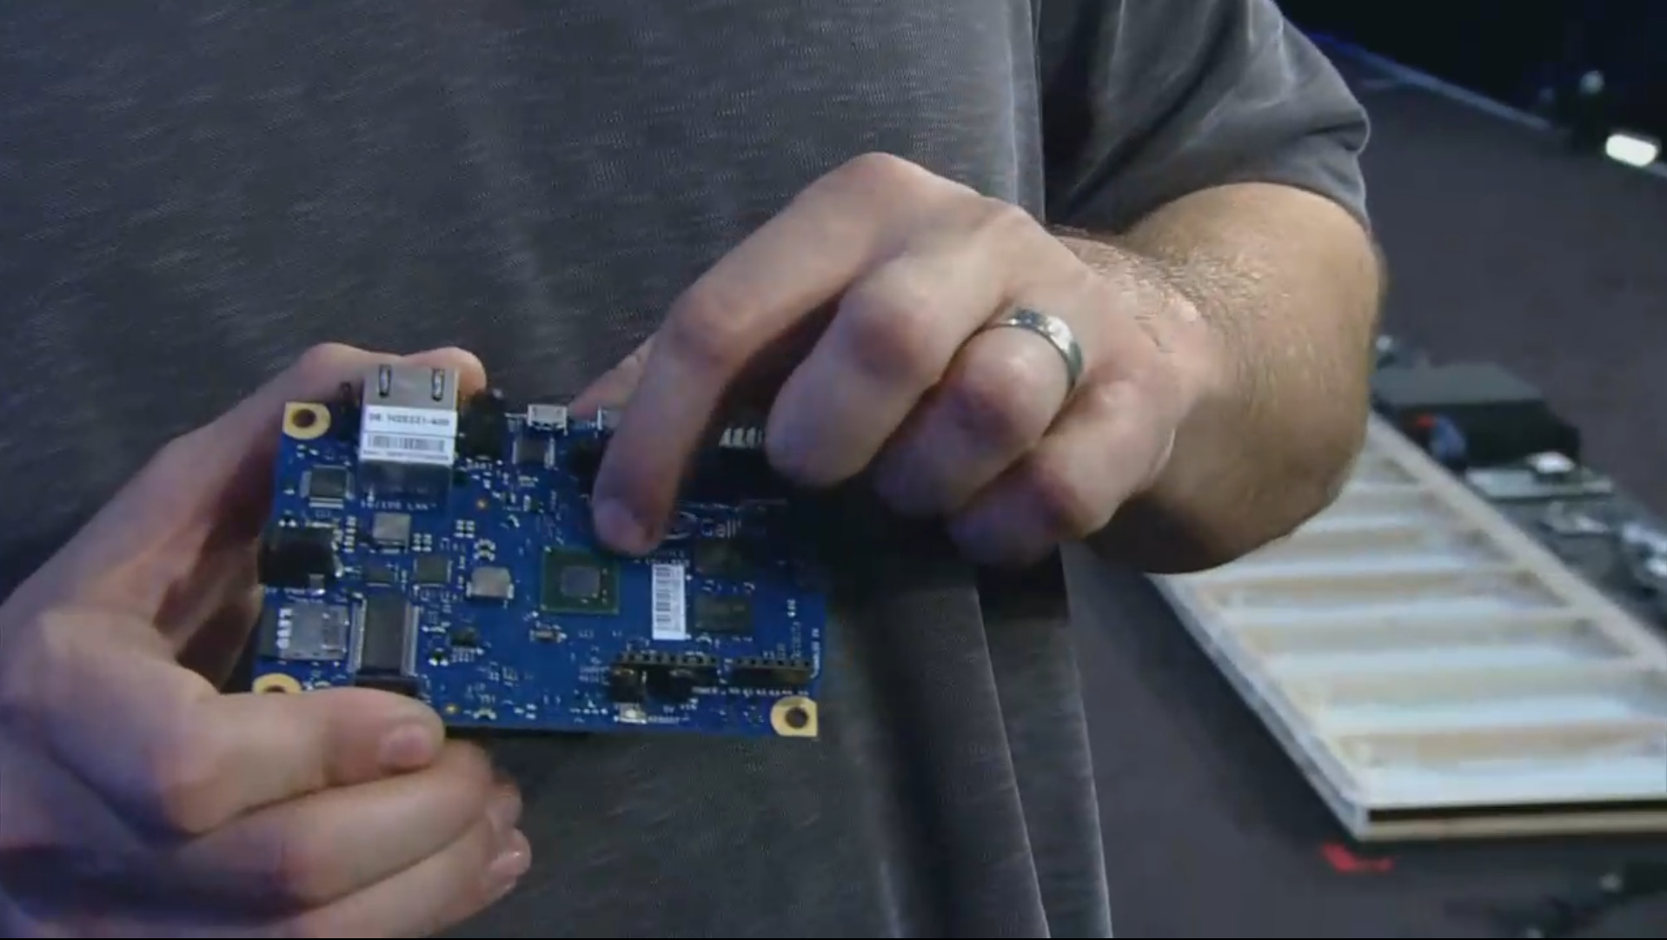

Slide 38
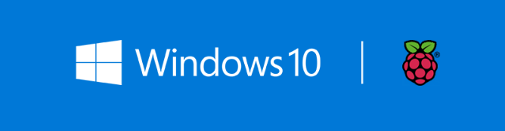
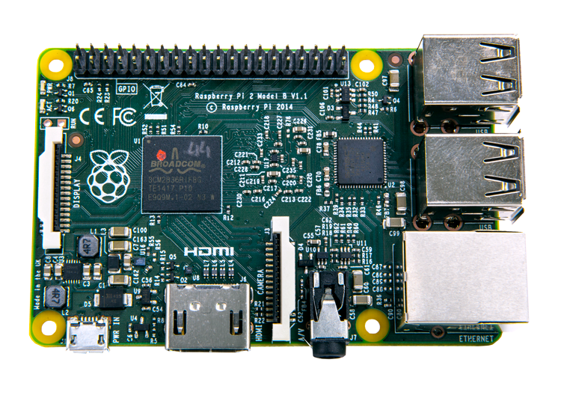

Slide 39
Pricing
=
Windows on Devices
Windows available for $0

Slide 40
Pricing
=
<9”
Phones and tablets with screens less than 9”
Windows available for $0

